Slide 1
TEAM5OARS Online Apartment Rental System PRESENTATION Spring 2016
Online Apartment Rental System
Luis Silva, Anthony Cortes, Nixon Mathew, Kaisong Fan, Keith Russell, Sai Vadlamani, Visak Varghese

Slide 2
TEAM5OARS Online Apartment Rental System DATABASE BACK END
Added by VH; Please discuss DB first
Please place these as dividers

Slide 3
TEAM5OARS Online Apartment Rental System Data Analysis – ERD Model
Summary of #Es, #Rs, and #As.
ERD Model

Slide 4
TEAM5OARS Online Apartment Rental System Contract – Data Requirements Specification
Summary of #Es, #Rs, and #As.
Table 1. Data Requirements
Table 2. Constraints

Slide 5
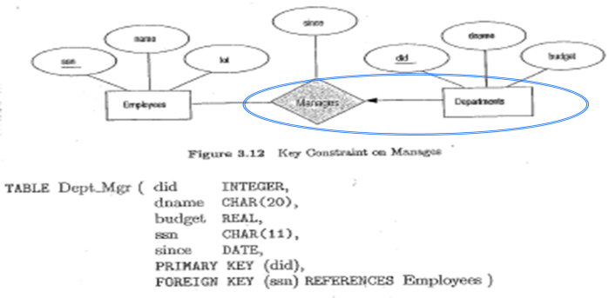
TEAM5OARS Online Apartment Rental System Data Design – Relational Model
ERD with “labeled ovals” showing the Relations.
TABLE … format to describe the Relations.
(please see the MRT 13 – Relational Model, also
shown below
)

Slide 6
TEAMOARS Online Apartment Rental System FRONT END
Added by VH;
Please place these as dividers

Slide 7
TEAM5OARS Online Apartment Rental System Business Modeling: UML USE CASE Model
Actors;
UML USE CASE Model

Slide 8
TEAM5OARS Online Apartment Rental System Contract: Software Requirements Specification
Summary of Ucs;
Table 3.2 Functional & Non-Functional Requirements;
Appendix with Actors and UML USE CASE Diagram.

Slide 9
TEAM5OARS Online Apartment Rental System Software Project Management Plan
COCOMO II Estimates, screenshot of the CASE TOOL;

Slide 10
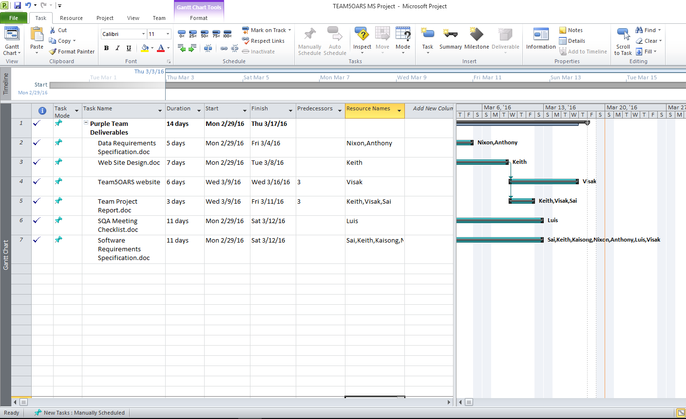
MS Project Plan

Slide 11
TEAM5OARS Online Apartment Rental System Chat Demo
Go to purechat.com > Sign up > Copy snippet code > paste before end of </body>
Live Chat demo.

